Slide 1

Removal of Duplicate Certificates of Title

Slide 2
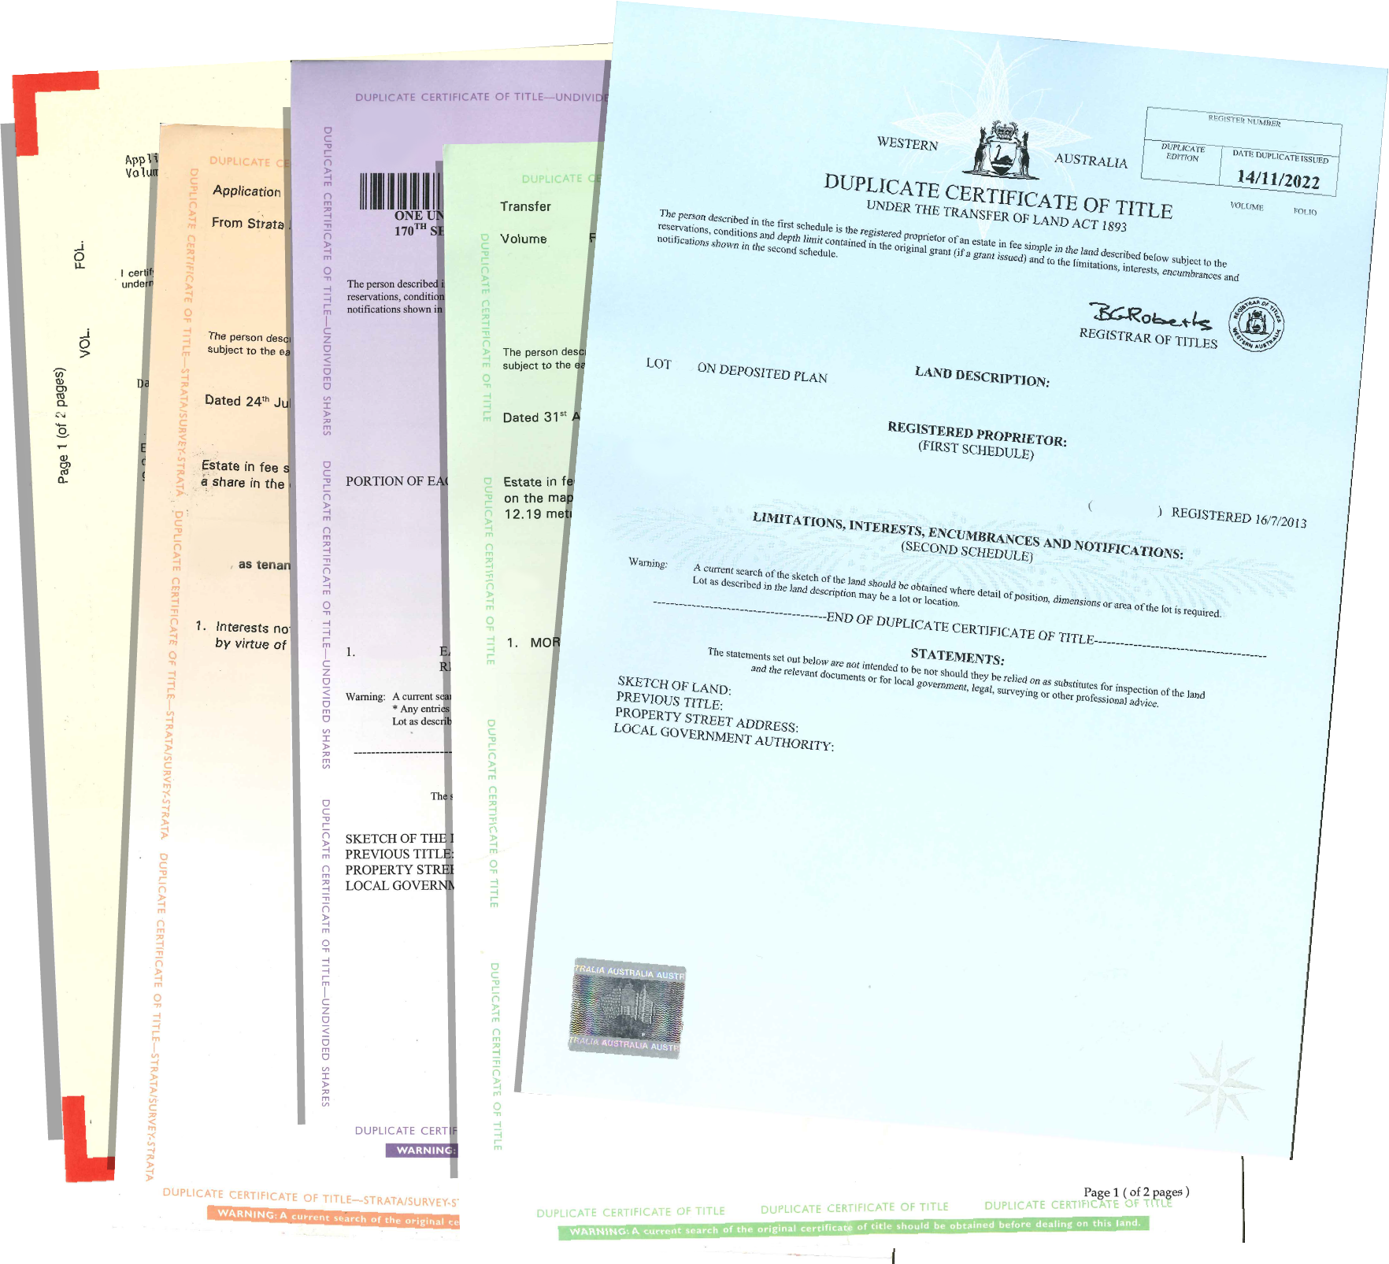
What is the Transfer of Land Amendment Act 2022
The Transfer of Land Amendment Act 2022 is an act of Parliament which was passed in June 2022 which amends the Transfer of Land Act 1893
The key change which will be happening in August 2023 is Duplicate Titles will be removed from use in Western Australia’s land titling system

Slide 3
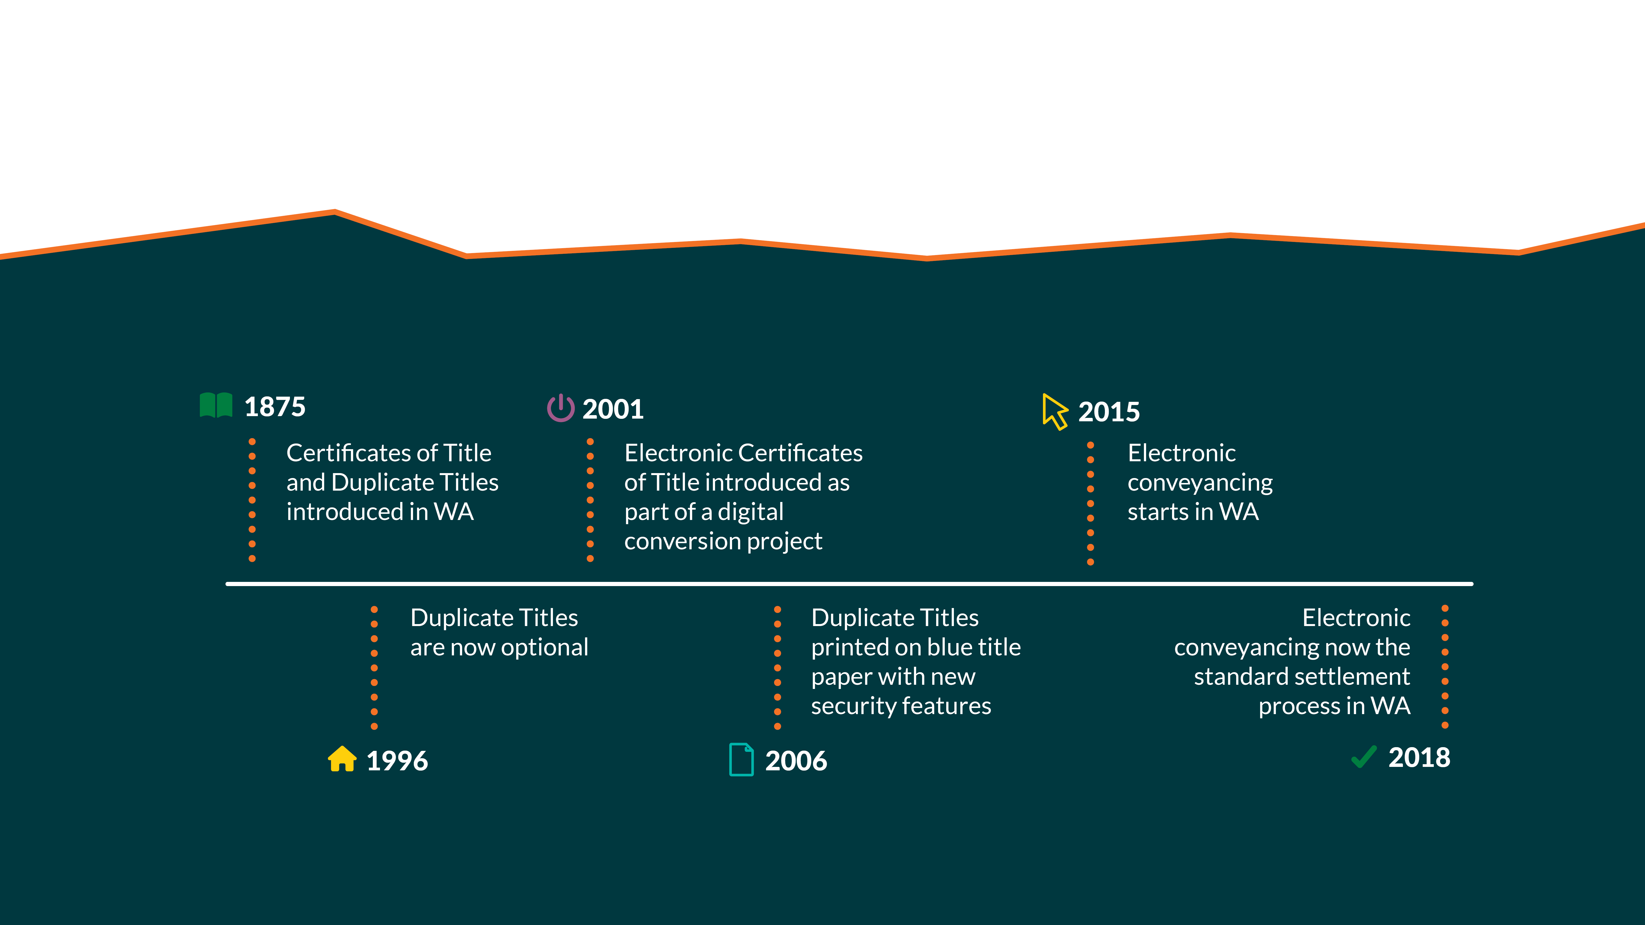
WA Land Titles Timeline

Slide 4

Why remove Duplicate Titles?
Removing Duplicate Titles aligns WA with most other states
Duplicate Titles have been optional for over 25 years and now more than half of all freehold titles are already paperless
A Duplicate Title is a paper version of the Original Title with some differences and limitations which many people may be unaware of

Slide 5
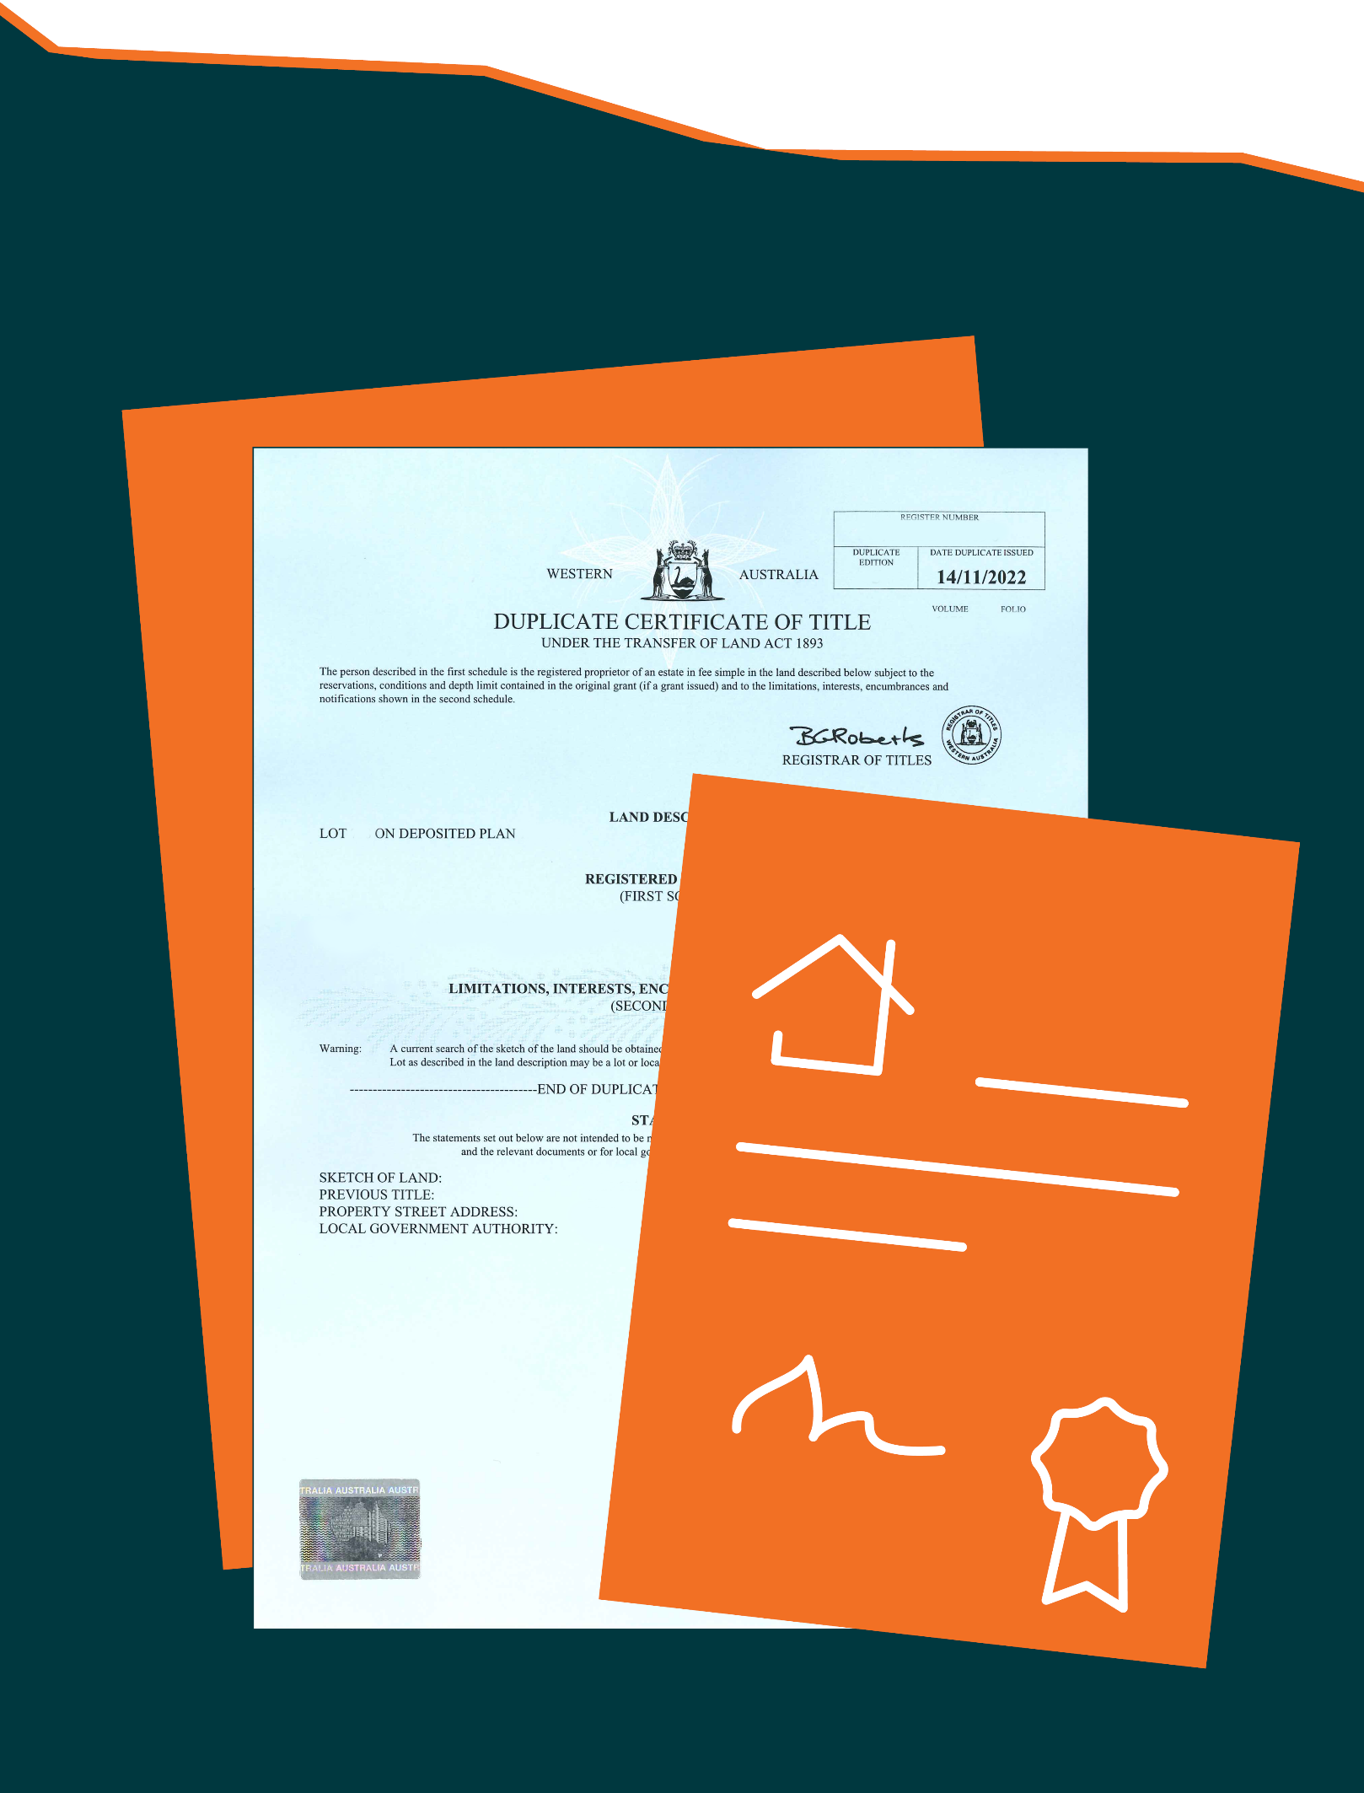
What does this mean for you?
From 7 August 2023:
Duplicate Titles will no longer be created or used in the WA land titling system
Existing Duplicate Titles will no longer be legal documents
Mortgagees no longer need to store paper Duplicate Titles as security for mortgages
Conveyancing, both in paper and electronically, will be simplified for all parties to the land transaction
If you hold a Duplicate Title as security for money you have loaned to somebody, you should obtain advice from a qualified industry professional before the changes take effect

Slide 6

Safety and Security
We are committed to maintaining the safety and security of your Certificate of Title by:
Requiring the verification of identity and establishing the transacting party’s right to deal as part of property transactions
Following the WA Government's Cyber Security policy to protect personal information and mitigate cyber risk
Applying a range of secure checks for land transactions lodged through WA's electronic conveyancing network

Slide 7
  Awareness campaign and information sharing with public, banks, conveyancers and lawyers
  Landgate, PEXA and Sympli removing Duplicate Title functionality from IT systems
  Updating publications including Registration Procedure Guides
What is happening?

Slide 8
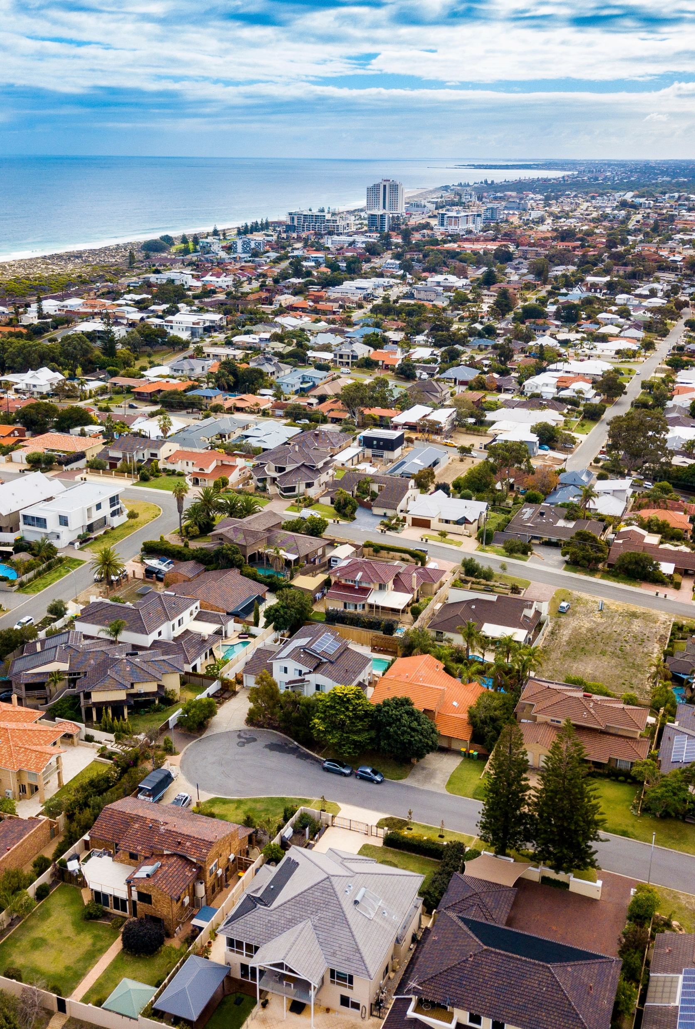


Where to find information
Dedicated web page on Landgate website
containing information and education material
FAQs for removal of Duplicate Titles, Fact sheet, Animated explainer video
Dedicated email address for TLAA enquiries TLA.Amendments@landgate.wa.gov.au

Slide 9
Thank you

